Slide 1
Sentiment-Analysis
Vocational Training Project

Slide 2
Introduction
Our mini-project focused on developing a model to accurately classify text sentiment, a core task in Natural Language Processing (NLP). We implemented a Logistic Regression model, a robust and interpretable algorithm, for this purpose. The model was trained and evaluated using the extensive IMDb movie review dataset, comprising 50,000 reviews.
Through careful data preprocessing and model tuning, we achieved a high accuracy of 88.5% in predicting sentiment, demonstrating the effectiveness of Logistic Regression for binary text classification. This project successfully showcased fundamental concepts of NLP and machine learning classification in a practical application.

Slide 3
Objective
Build a Robust Model
Develop a Logistic Regression model capable of performing binary sentiment classification (Positive/Negative) with high reliability and efficiency.
Achieve High Accuracy
Ensure the model's accuracy on unseen data surpasses 85%, validating its predictive power and generalizability.
User-Friendly Interface
Design a simple, intuitive user interface that allows for easy text input and clear display of the predicted sentiment.

Slide 4
Key Architecture & Tools used
Python 3.9+
NLTK
Matplotlib & Seaborn
Pandas
Jupyter Notebook / VS Code

Slide 5
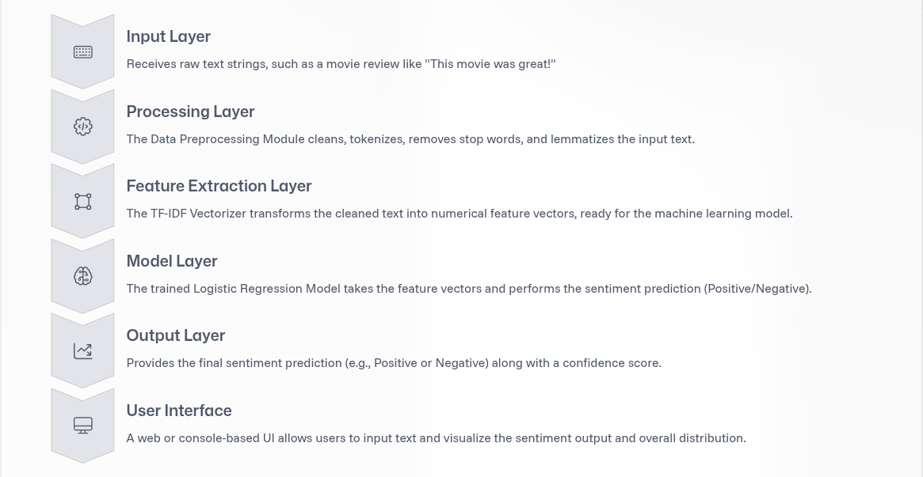
Sentiment Analysis Pipeline

Slide 6
Data Processing
1. Data Collection
We sourced the IMDb movie review dataset, which consists of 50,000 movie reviews, perfectly balanced with 25,000 positive and 25,000 negative sentiments.
2. Cleaning
Initial cleaning involved removing irrelevant elements such as HTML tags, URLs, numbers, and special characters, which do not contribute to sentiment.
3. Tokenization
Text was broken down into individual words or "tokens," forming the basic units for analysis.

Slide 7
4. Stop Word Removal
Common words like "a," "the," "is" (stopwords) were eliminated as they add noise without significant semantic value for sentiment.
5. Lemmatization
Words were reduced to their base or root form (e.g., "running" becomes "run") to minimize vocabulary size and consolidate word meanings.
6. Vectorization
Finally, cleaned and lemmatized text was transformed into numerical vectors using TF-IDF (Term Frequency-Inverse Document Frequency), enabling the Logistic Regression model to process them.

Slide 8
Application
Product Reviews: Automatically analyze customer feedback to identify strengths and weaknesses.
Social Media Monitoring: Track public opinion and brand perception in real-time.
Customer Service: Prioritize support tickets based on customer frustration levels.

Slide 9
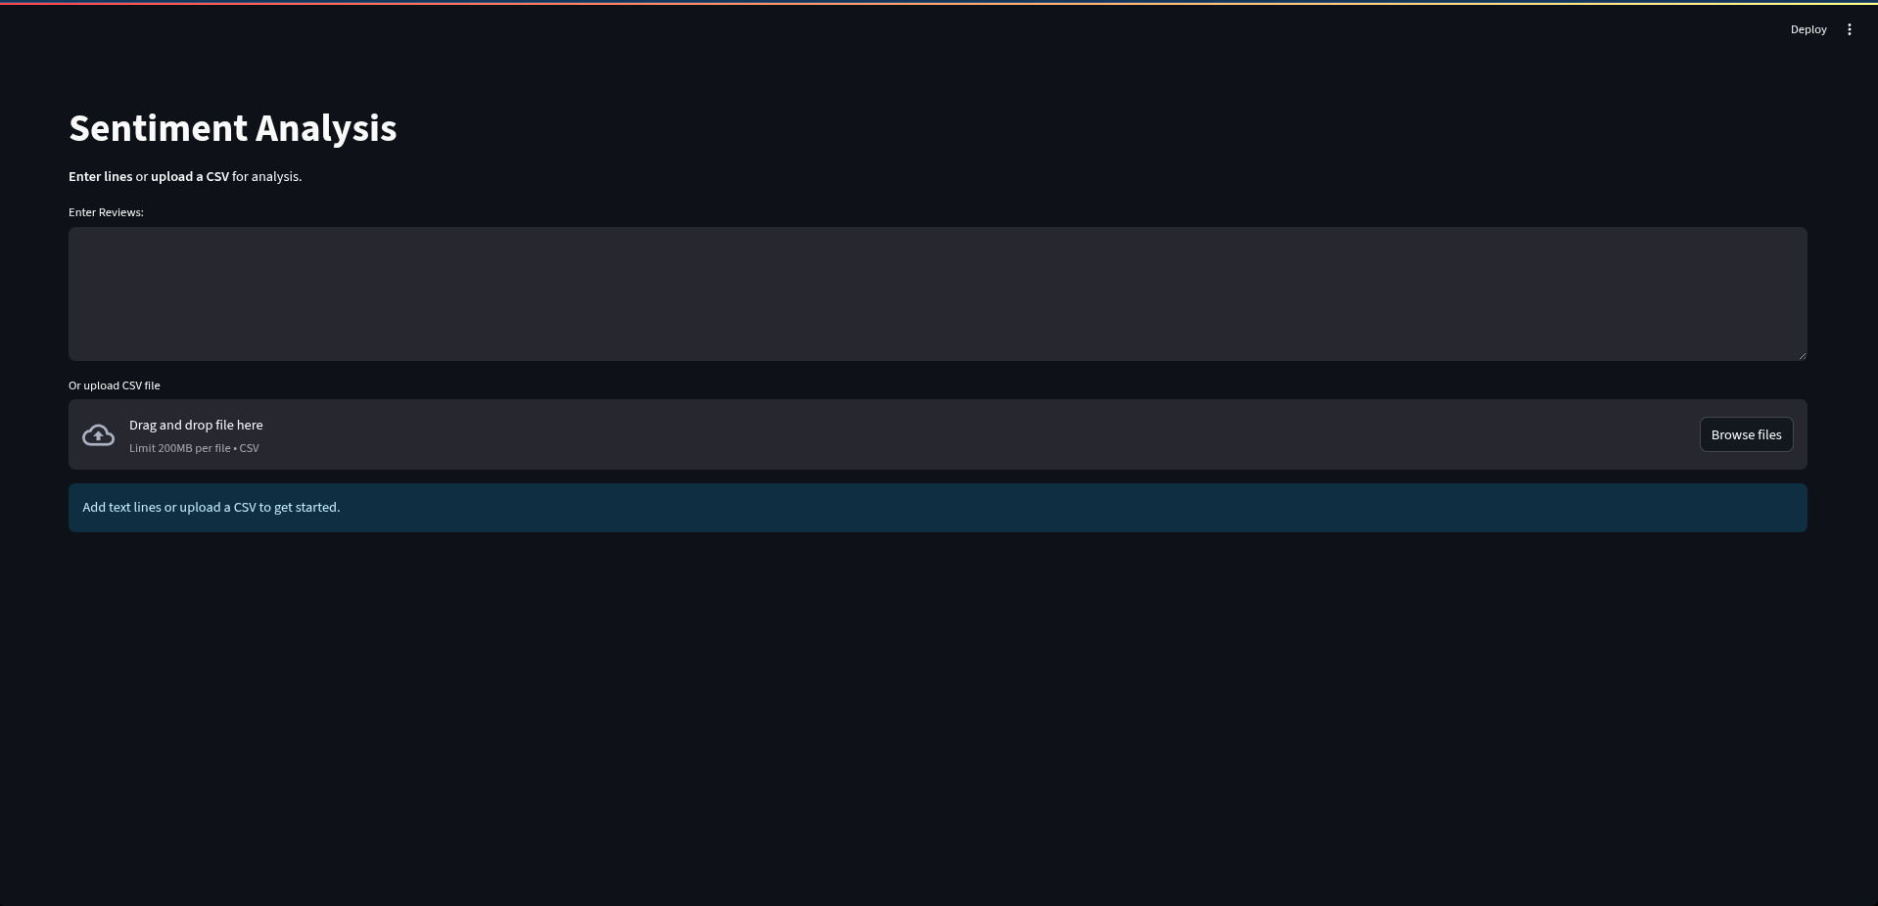
Streamlit UI

Slide 10
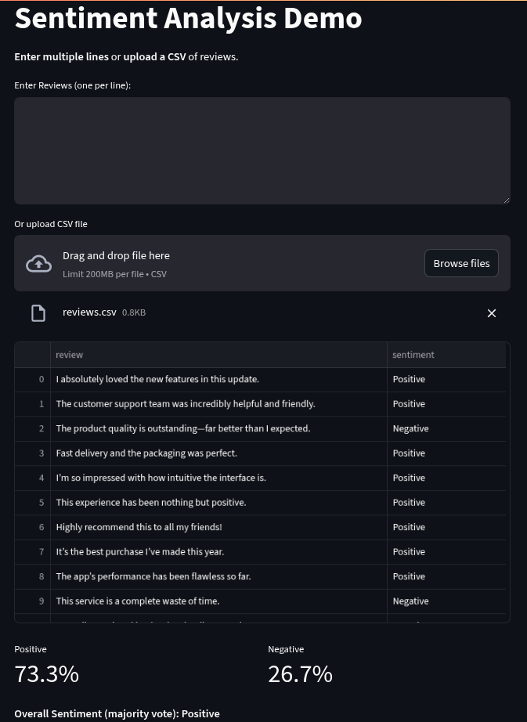
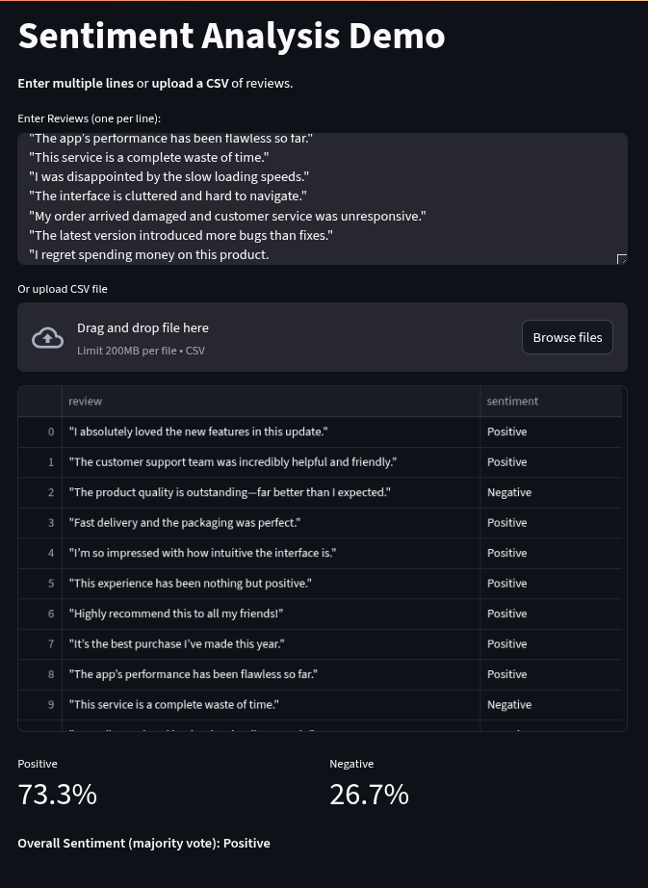
Result

Slide 11
Conclusion
This mini-project successfully established a foundational sentiment analysis system using Logistic Regression. We demonstrated its effectiveness in classifying movie review sentiments with high accuracy, proving the practical application of machine learning in Natural Language Processing. This project serves as a solid stepping stone for further exploration into advanced text analytics and AI applications.
"Understanding language is the first step towards understanding the world."

Slide 12
Future Scope
1. Advanced Models
Explore sophisticated deep learning models like Recurrent Neural Networks (RNNs), Long Short-Term Memory (LSTM) networks, or Transformer-based models for potentially higher accuracy and handling of complex language nuances.
2. Multi-Class Sentiment
Extend the model to classify sentiment into more granular categories, such as neutral, mixed, or even specific emotions like joy, anger, or sadness.
3. Real-time Data Integration
Integrate the system with live data streams, such as the Twitter API, to perform real-time sentiment analysis on trending topics or public discourse.

Slide 13
Thank You …..

